Slide 1
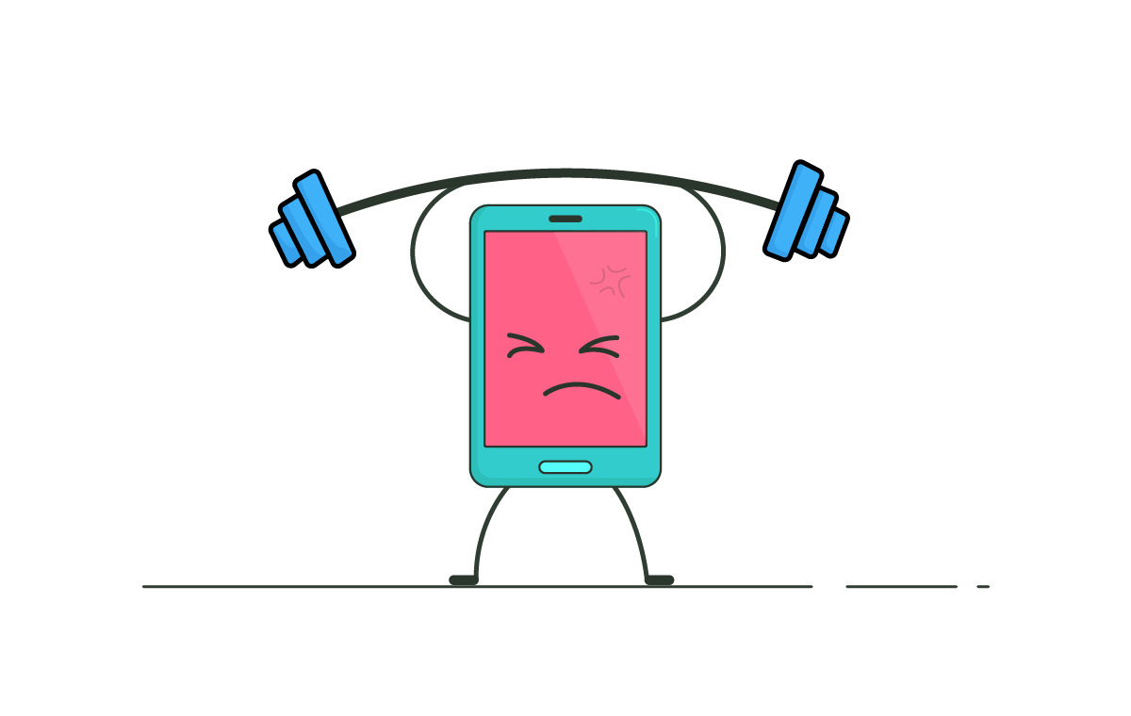
Stress and load testing

Slide 2
Lets start with why ?
Think about course registration system in university
We all waiting for our time to login, but we are not alone.
All the university students try to login while we are trying too

Slide 3
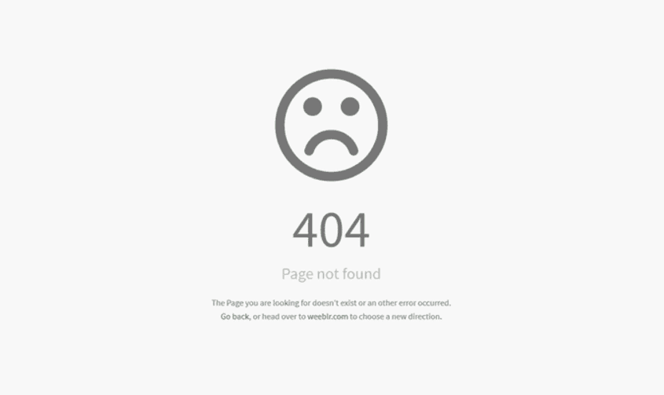
What we get…

Slide 4
Why error ?
Too much users try to use the system.
The server cant handle this number of users.
The system designed for 5000 users, but 10000 users tried to login.
The QA didn't perform load testing well
The QA didn't perform stress testing well

Slide 5
Load testing
Load Testing is a type of performance testing which determines the performance of a system.
determines a system's performance under a specific expected load
It checks how the application behaves during normal and high loads.
This type of testing is applied when a development project nears to its completion.

Slide 6
Stress testing
Stress testing is a type of software testing that verifies the stability and reliability of the system.
Stress testing is testing that checks the upper limits of your system by testing it under extreme loads.
The testing examines how the system behaves under intense loads, and how it recovers when going back to normal usage
Stress testing tries to break the system under test by overwhelming its resources.

Slide 7
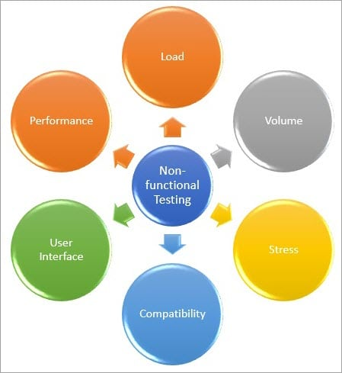
Non-functional testing

Slide 8
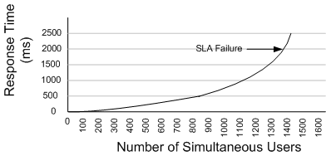
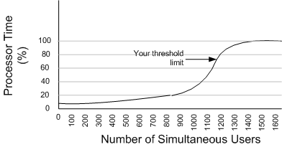
Analyze load testing results
CPU Utilization: When User load equals to 1200 concurrent users, Web server starts utilizing more processor time.
Response Time: When user load equals to 1300 concurrent users, User starts experiencing slow response of web pages.

Slide 9
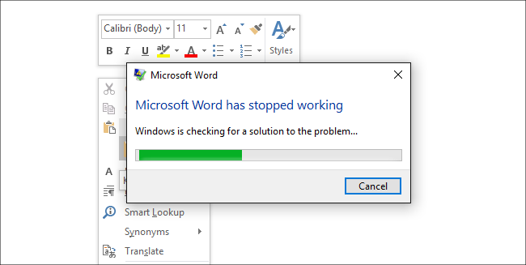
Analyze stress testing results
Word application stress testing while trying to copy a lot of data to the application :

Slide 10
Difference between stress and load testing
Load testing
Stress testing
Load Testing is performed to test the performance of the system or software application under extreme load.
Stress Testing is performed to test the robustness of the system or software application under extreme load.
01
01
The factor tested during stress testing is robustness and stability.
02
The factor tested during load testing is performance.
02
03
recognize the upper limit of the system
check out how the system behaves under extreme loads and how it recovers from failure.
03
make sure that the system has saved the data before crashing or not.
04
assure that application able to achieve the performance that we want
04

Slide 11

Apache Jmeter
The Apache JMeter is pure Java open source software, designed to load test and measure performance.
You can use JMeter to analyze and measure the performance of web application
Displays test results in a variety of ways, including charts, trees, tables or log files.
User-friendly graphical user interface (GUI).

Slide 12
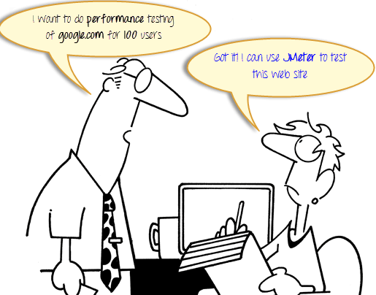
Why using Apache Jmeter?
your boss asks you to do load testing of www.google.com for 100 users.
It's not feasible to arrange 100 people with PC and internet access simultaneously accessing google.com
Even if you arrange 100 people with PC , your boss can ask from you to do load testing fo 1000 users.
Hence you need a software tool like JMeter that will simulate real-user behaviors and performance/load test your site.

Slide 13
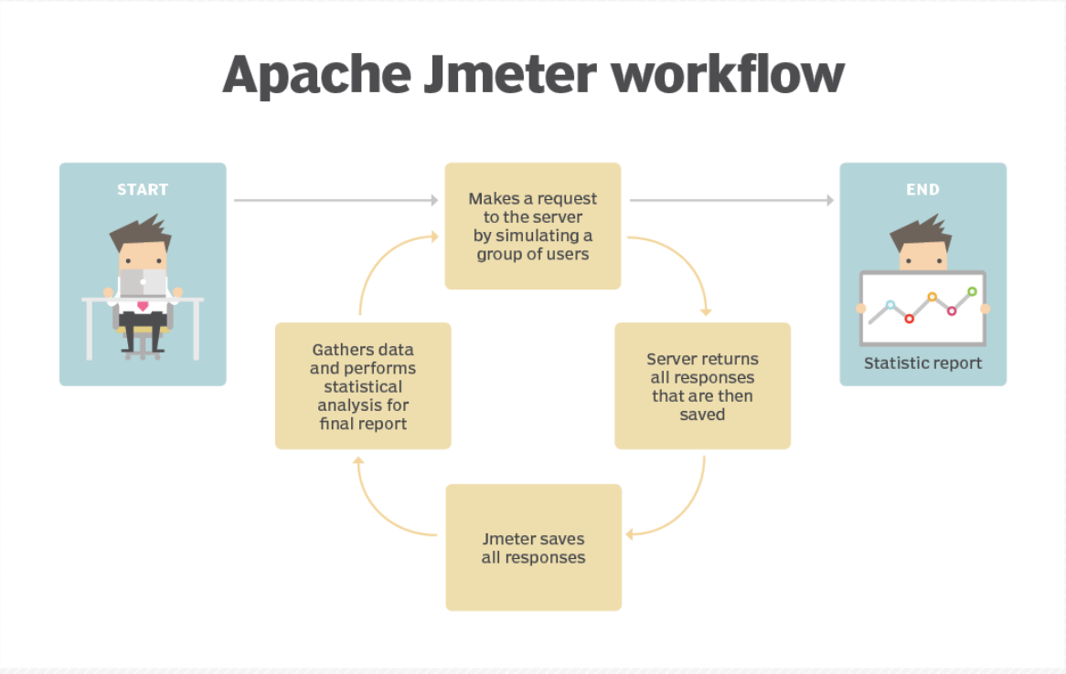
How it works ?

Slide 14
Testing E-commerce system
The stability of the e-commerce website depends on various conditions, one of them is the number of users to make transactions within a specific period of time on the website.
So if there are too many users use the system at the same time, the loading speed of the website needs to be considered in order to avoid the risks in payment transactions, user experience, and customer trust.
We have to make sure that the website will not crush while there is a lot of users that try to make transactions simultaneously.

Slide 15
Testing E-commerce system
Suppose that a lot of stores suggest products with huge discounts
Huge number of users will simultaneously accessing the system
This traffic will change the performance of the system
We need to simulate this scenario with Jmeter to investigate how much users can access the system simultaneously
Load testing the system will help us to make sure that our customers

Slide 16
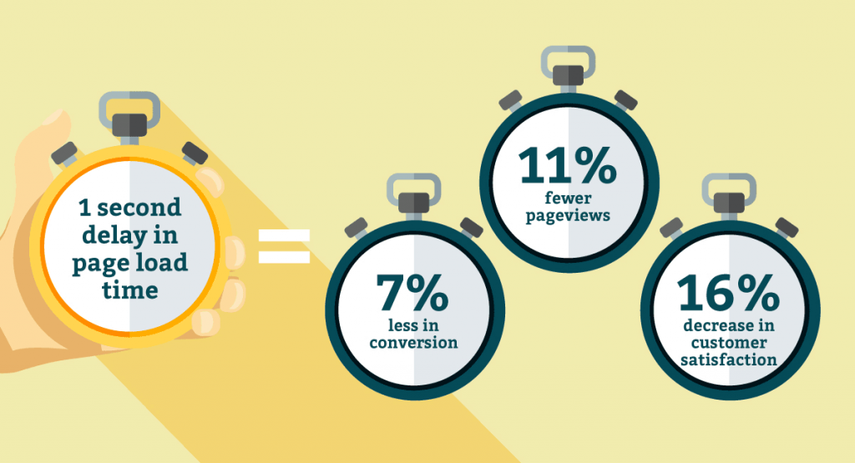
Testing E-commerce system
research shows that increasing a second (<= 2 seconds) in page load time can cause almost lost 7% in converting customers, lost more than 11% of page views and the satisfaction level of customers fell to 16%.

Slide 17
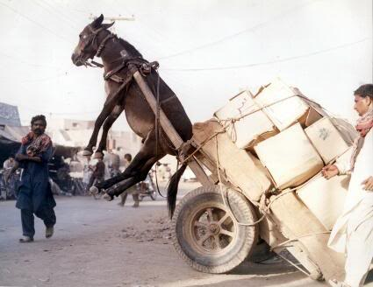
So…make sure you will test your system well!

